Slide 1

“In the beginning, God created the heavens and the earth.”
Genesis 1:1

Slide 2
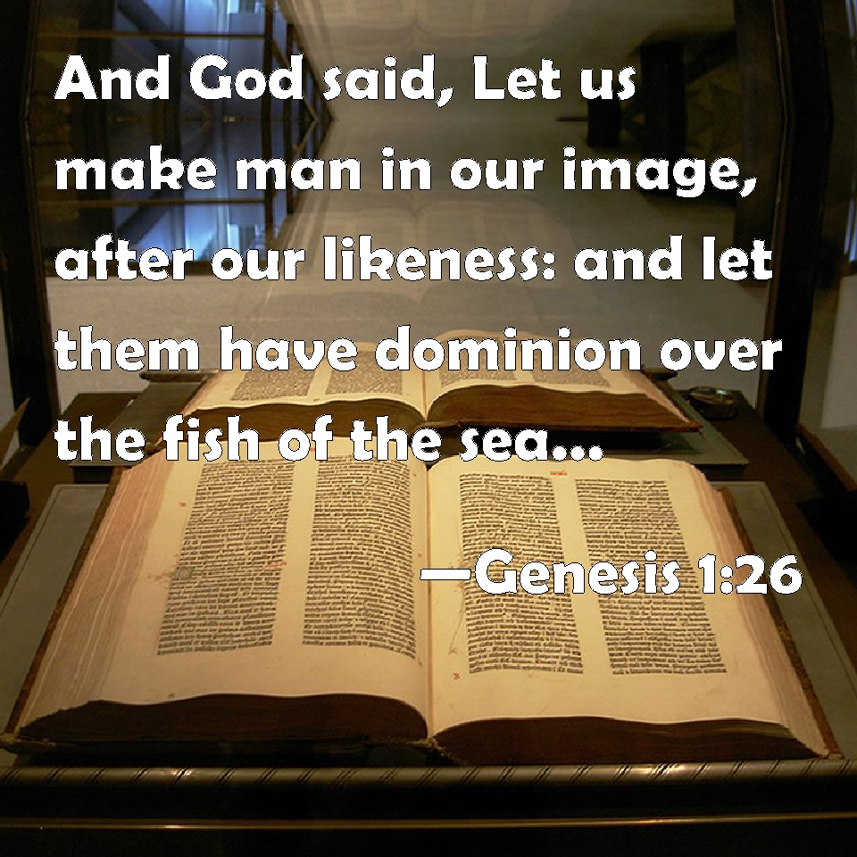
God Endowed Him With The Ability To Reason And Make Choices For Himself

Slide 3
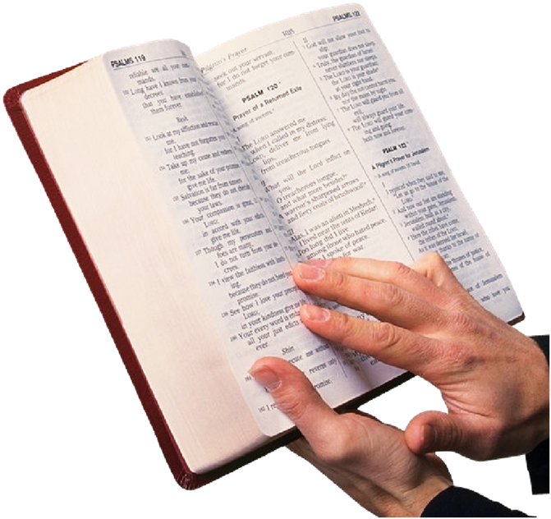
The Bible is God’s Will Revealed to Man
He tells us the things we need to know about His character, nature, and His attributes
His power over the armies if Egypt Exodus 14:26-28
He is a Jealous GOD Exodus 20:5
His omnipotence {all power} in Revelation 19:6
His omnipresence in such places as Jeremiah 23:23,24
His omniscience {all knowledge} in Hebrews 4:13

Slide 4
The god of christendom

Slide 5
The god of “Christendom”
“ONLY LOVES”
  No matter what you do or what life-style you pursue, we are told this god loves you!
  1 John 4:8 “God is love.”
  John 3:16 “God so loved the world…”
  Romans 8:38,39 “the love of God which is in Christ Jesus our Lord.”
  While God does love ALL MEN, He does NOT APPROVE of all men! Deuteronomy 6:14,15 “the anger of the Lord your God be aroused against you and destroy you from the face of the earth."

Slide 6
The god of “Christendom”
  Numbers 21:6-9 “So the Lord sent fiery serpents among the people, and they bit the people; and many of the people of Israel died”
  Romans 2:5-9 “those who are self seeking and do not obey the truth, but obey unrighteousness - indignation and wrath”
  Romans 11:22 “ consider the goodness and severity of God”
  1 Corinthians 6:9,10 “unrighteous will not inherit the kingdom of God
  2 Thessalonians 1:6-10 “taking vengeance…those who do not know God, and on those who do not obey the gospel”

Slide 7
The god of “Christendom”
  Needs Man’s Help
  Genesis Chapter 17 – Through ISAAC all nations would be blessed
  Sarah thought GOD needed some HELP!
  Korah, Dathan & Abiram – Numbers Chapter 16
  Does God need men's help? NOT AT ALL!
  Acts 17:24,25 “as though He needed anything, since He gives to all life, breath, and all things."
  What Man Thinks About God –doesn’t CHANGE GOD! Romans 3:3,4

Slide 8
The god of “Christendom”
  Accepts All Faiths
  “Join the church of your choice.”
  “As long as one is sincere, that’s all that matters.”
  “We are all heading for the same place…”
  Frequently wrest such passages as John 15:1-6
  God’s attitude toward anything OTHER than the TRUTH – Galatians 1:6-9,23 “preaches the faith which he once {tried to} destroy."
  God told Paul NOT to preach or accept ANY OTHER!

Slide 9
The god of “Christendom”
  Accepts All Faiths
  Ephesians 4:5 "one Lord, one faith, one baptism."
  1 Timothy 4:1-4 “in latter times some will depart from the faith”
  THE FAITH is that which Jude says was “once for all delivered to the saints” Jude 3,4
  God will accept those who have accepted HIM by OBEDIENCE TO HIS WILL – Hebrews 5:8,9 “author of eternal salvation to all who obey Him.”

Slide 10
The god of “Christendom”
  Will Save All
  “Second chance beyond the grave”
  “Baptism for the dead”
  “How could God send man, whom He loves, to a place where he will be eternally separated from Him?”
  1 Timothy 2:3,4 “desires all men to be saved and to come to the knowledge of the truth."
  2 Peter 3:9 “that all should come to repentance."

Slide 11
The god of “Christendom”
  Will Save All
  What about Matthew 7:13,14? SOME who will find the way that leads to LIFE, and the MAJORITY will travel the way that leads to DESTRUCTION!
  2 Thessalonians 1:7-9? Jesus come with "flaming fire taking vengeance on those who do not know God, and…do not obey the gospel“ and…cause SOME to suffer "everlasting destruction”
  1 Peter 4:17,18 “righteous one is scarcely saved, where will the ungodly and the sinner appear?"

Slide 12
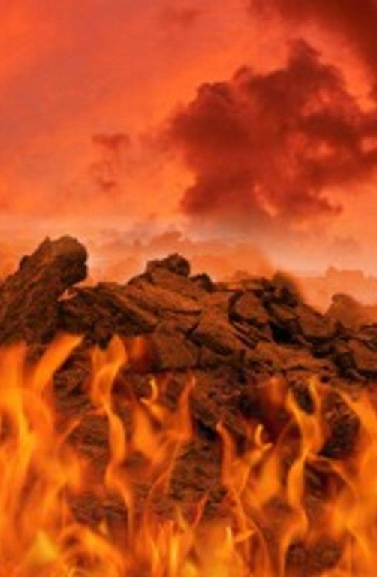
Clearly NOT ALL men will be saved!
It is NOT God’s Choice but MAN’S!

Slide 13
The god of “Christendom”
  May Be Worshiped Anyway Man Chooses!
  “Sincerity, love, reverence and a proper attitude is enough”
  "Not under law," only "core essentials", and can change the worship as we deem best."
  Acts 17:22,23 not only matters WHO you worship, but HOW you worship them!
  Matthew 15:7-9 “in vain they worship Me”
  John 4:23,24 “must worship in spirit and truth."

Slide 14
The god of “Christendom”
  Will Not Punish
  “Against God’s nature to punish one of His children.”
  "It is not RIGHT to serve God out of fear."
  "Why would He create us just to punish us?"
  Hebrews 10:26-31” It is a fearful thing to fall into the hands of the living God."
  Acts 17:30,31”He has appointed a day on which He will judge the world in righteousness”
  Matthew 25:41-46 “Depart from Me, you cursed, into the everlasting fire”

Slide 15
The god of “Christendom”
  But what about all these SINCERE, RELIGIOUS PEOPLE out here who are worshiping this GOD OF CHRISTENDOM they have created?
  Matthew 7:21-23 “have we not prophesied in Your name, cast out demons in Your name, and done many wonders in Your name?’”
  John 5:28,29 Condemnation call for PUNISHMENT
  It is not God’s desire to send us to everlasting punishment, it is a matter of OUR CHOICE
  WE CANNOT BLAME GOD!

Slide 16
The god men have created may bring them much more comfort & peace of mind than the God of heaven!
  But we cannot find him in the Bible!
  God is eternal in His attributes and cannot change!
  Have you created a different God in your life?
  Why not come to the TRUE and LIVING GOD in FAITH RIGHT NOW!
  Confess His Son Jesus as the Christ from a penitent heart, and be baptized for the remission of your sins!

